Slide 1
Computer Forensics

Slide 2
Devices which holds the forensic value

Slide 3
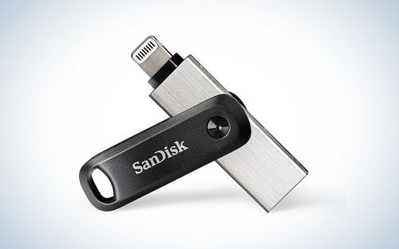
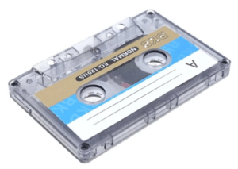
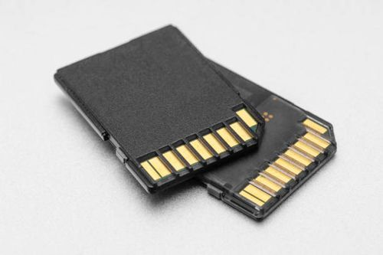
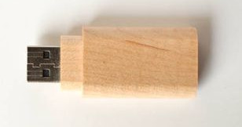
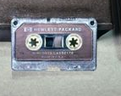
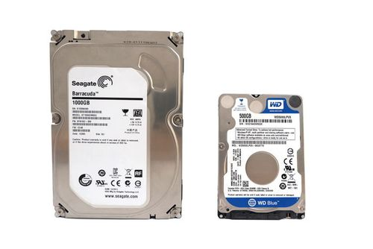

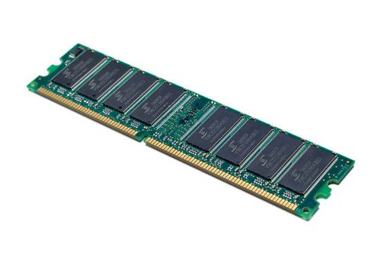
Memory Card
Magnetic Tape
Flash Drive ( Pen Drive)
RAM(MEMORY)
HDD( HARD DISK DRIVE)
CD OR DVD

Slide 4
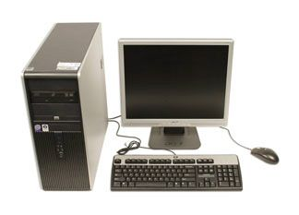
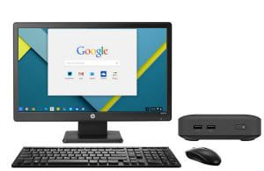
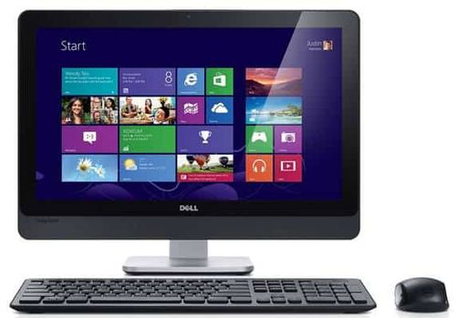
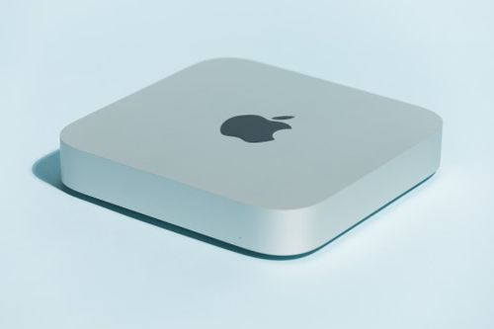
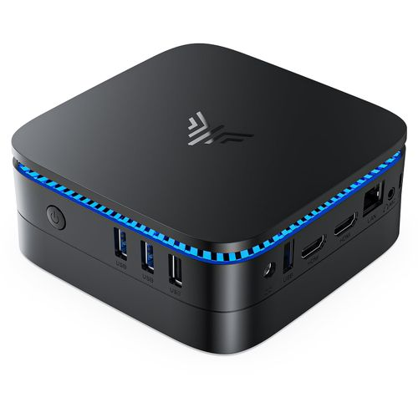
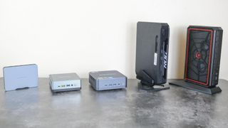
Computer

Slide 5
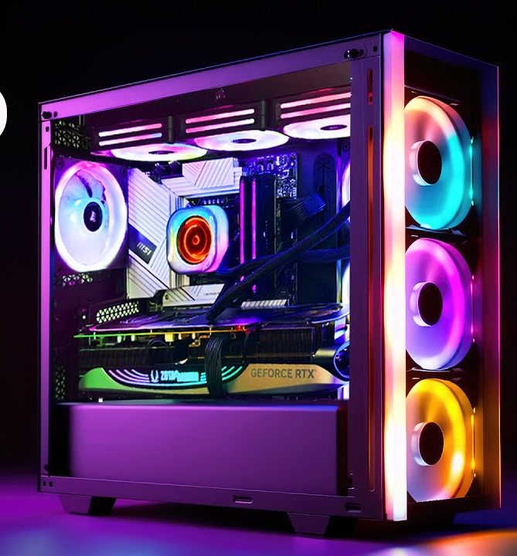
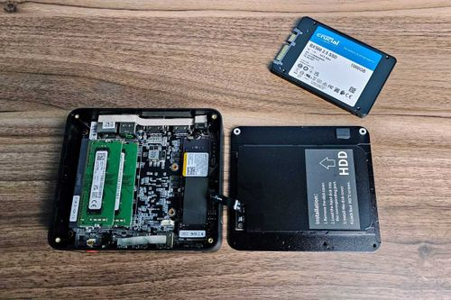
Internals of Desktop

Slide 6
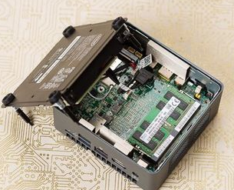
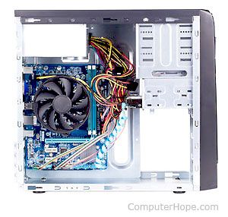
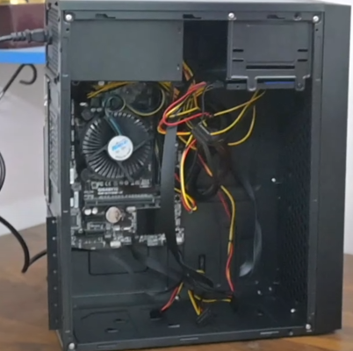
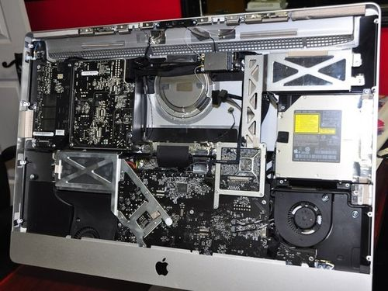

Slide 7
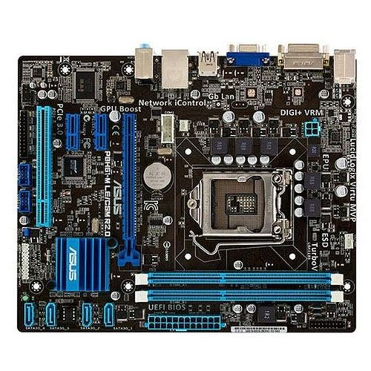
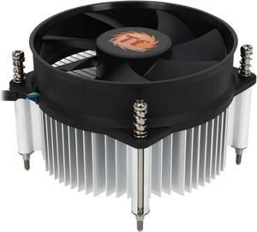
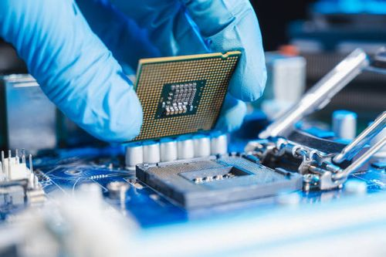
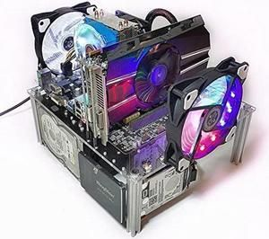
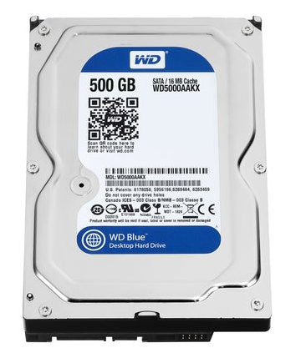
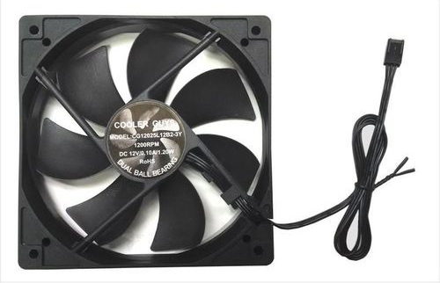
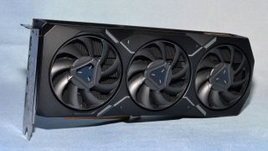
Parts of Computer
RAM
Motherboard
CPU (Brain)
CPU COOLING FAN
COOLING FAN
HARD DISK
GPU

Slide 8
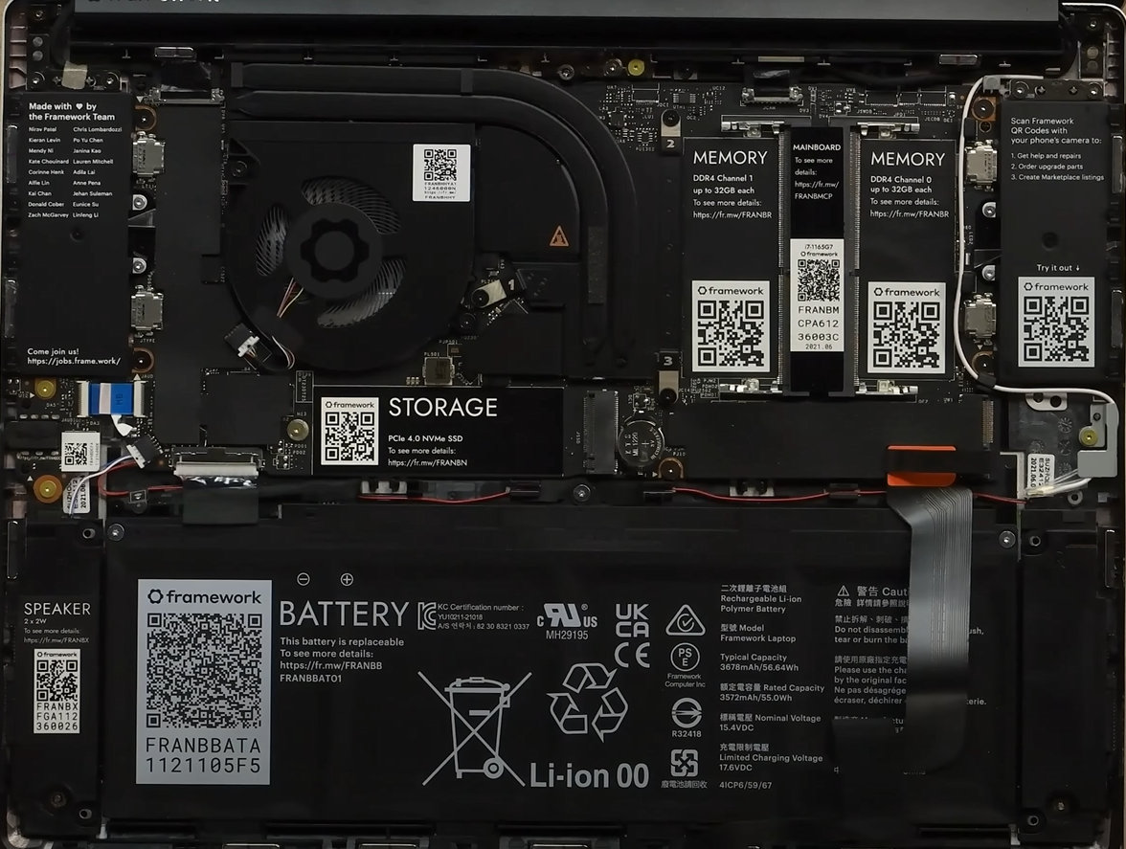
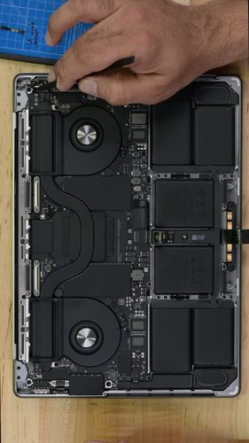
Laptops:

Slide 9
Why Computer need Memory(storage) ?
A computer without memory(storage) wouldn’t be able to load or run programs. The CPU requires memory to fetch instructions and store data as it processes tasks. Without it, the CPU wouldn’t know what to do or where to find the data it needs.
So how many types of memory(storage) are there?

Slide 10
Primary(Temporary) and Secondary Memory(Permanent)
Primary memory is the memory directly accessible by the CPU. It is used to store data and instructions that the CPU is actively working on. This memory is fast and volatile, meaning it loses its contents when the computer is powered off. Examples:- RAM, Cache
Secondary memory refers to storage devices that provide long-term data storage. Unlike primary memory, secondary memory is non-volatile, meaning it retains data even when the computer is powered off. Examples:- HDD, SSD, CD, DVD, Pen Drive, External HDD.

Slide 11
Comparison of Primary and Secondary Memory
Feature | Primary Memory (RAM) | Secondary Memory
Speed | Very fast | Slower
Volatility | Volatile (data is lost when power is off) | Non-volatile (data is retained)
Capacity | Limited (smaller in size) | Larger (greater storage capacity)
Direct Access by CPU | Yes | No (must load into RAM first)
Cost | More expensive per GB | Less expensive per GB
Examples | RAM, Cache Memory | Hard Drives, SSDs, USB Drives, DVDs

Slide 12
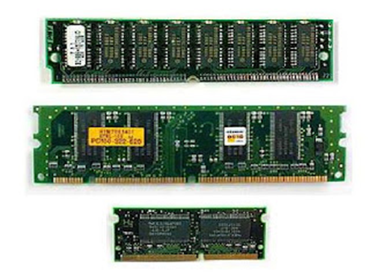
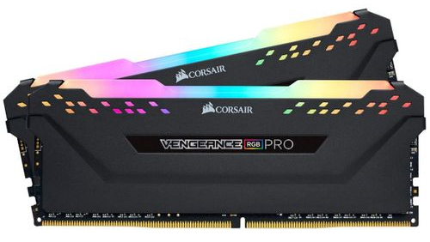
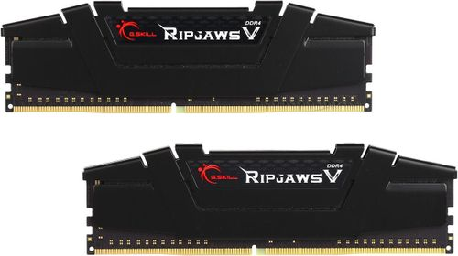
RAM(MEMORY) (Temporary Storage)
In Many Laptops
RAM is Soldered on
to the Motherboard.

Slide 13
RAM(MEMORY) and its importance in forensics
Contains the data of Open Files, Running Programs, Background Processes, Memory-resident Malware.
Contains the key of Bit-locked drive and Password Manager.
Contains the Active Network Connections(Ip address, ports), Routing Tables, Session Data(Web browsing sessions, email logs, chat history that could be actively ongoing)
System Information like: Login Info, System Logs, etc.

Slide 14
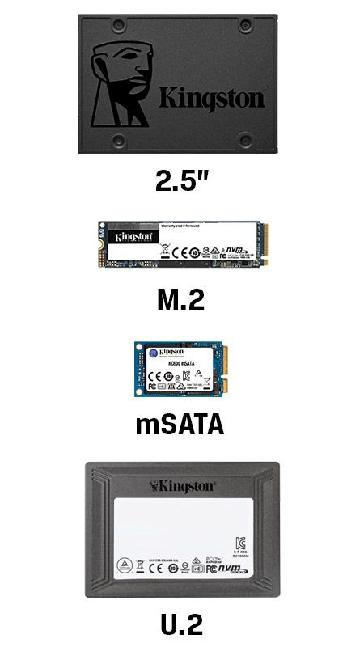
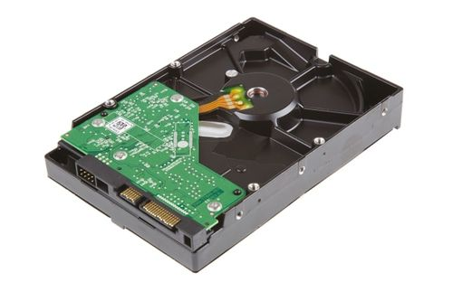
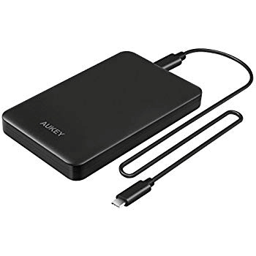
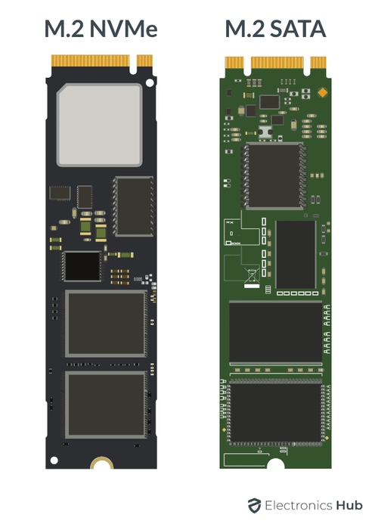
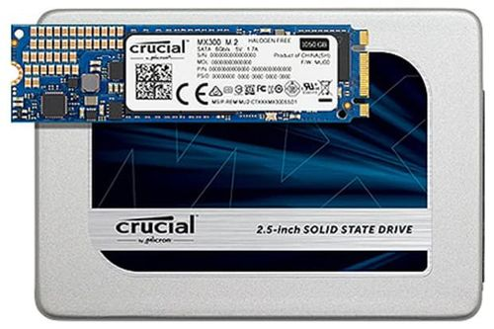
Hard Disk and Solid State Drives

Slide 15
Evidence present into the HDD or SSD
Artifacts: Pictures, videos, audio, emails, files and documents.
Metadata: Timesteps, permissions and asceses control lists(ACL) provide valuable context about file creation, modification and deletion.
Alternate Data Streams (ADS) : Hidden data within files, which can contain sensitive information, such as password or encryption keys.
File System Artifacts: Reconstruct the system and understand data modification timelines. By examining file metadata, logs, file slack, unallocated space, and other artifacts.

Slide 16
Collection of Evidence:

Slide 17
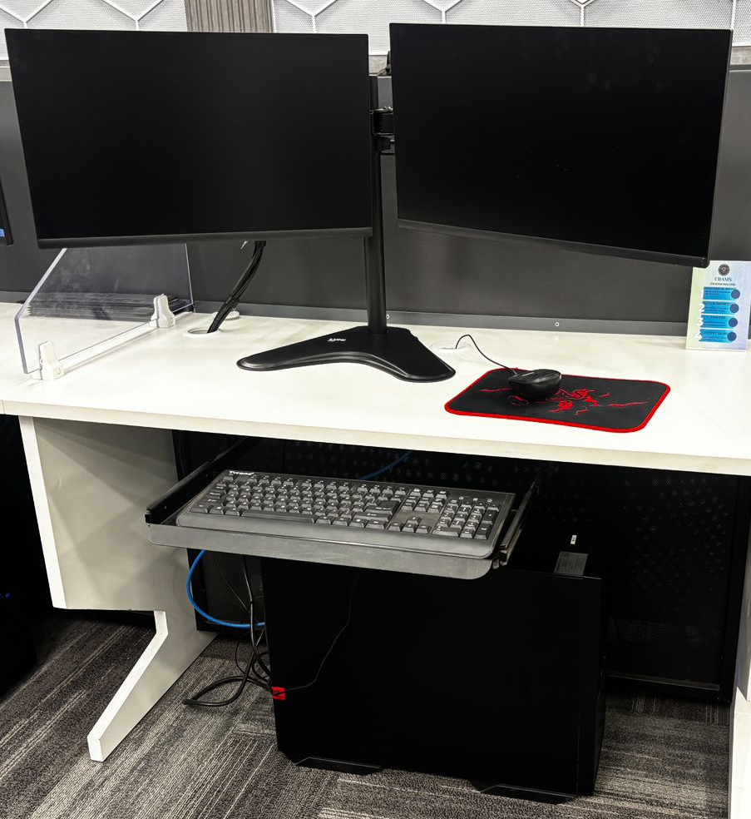
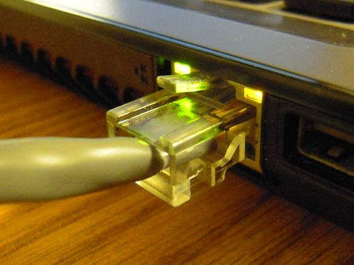
Secure and take control of the area.
Allow thee printers to finish the printing.
Move people away and
do not switch-ON the Computer(if Found in OFF condition).
Remove the Internet cable.

Slide 18
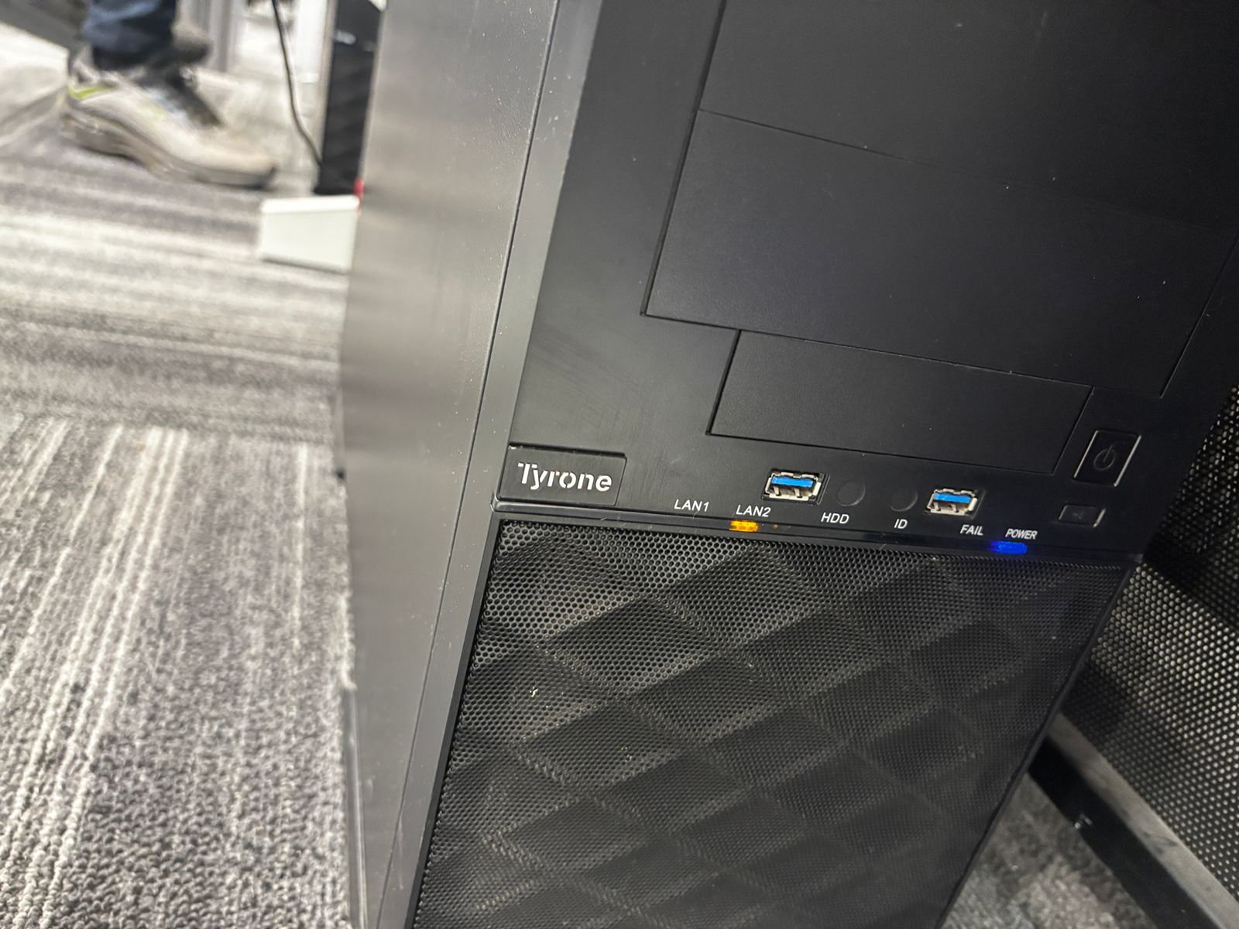
Make sure that the computer is switched off – Hard Drive and monitor activity lights or fans may indicate that machine is switched on.

Slide 19
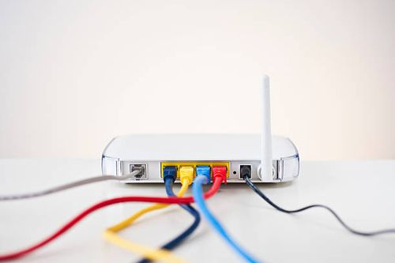
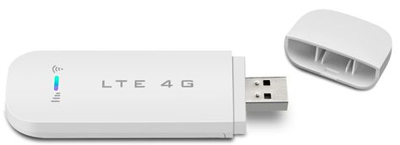
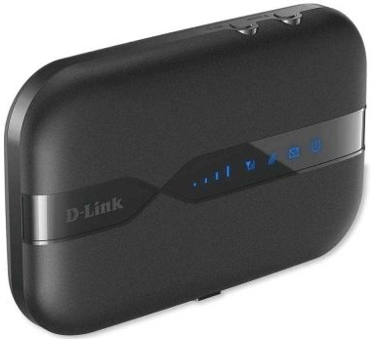
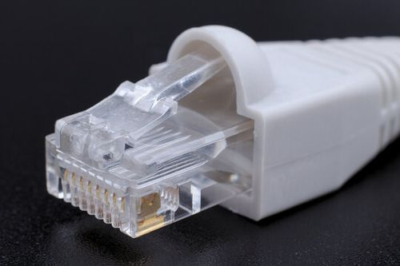
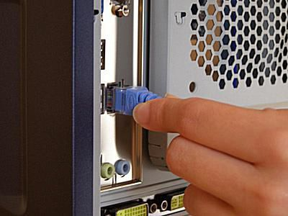
Disconnect the Modem if attached.
Remove the Cable

Slide 20
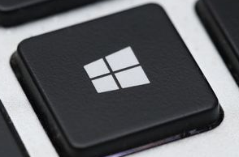
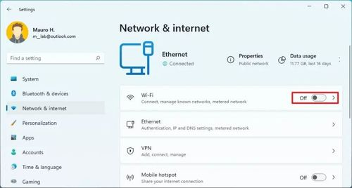
Press (Windows) + I on the Keyboard(both together).

Slide 21
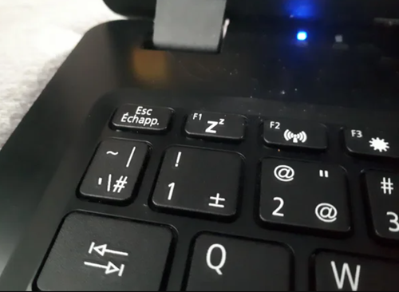
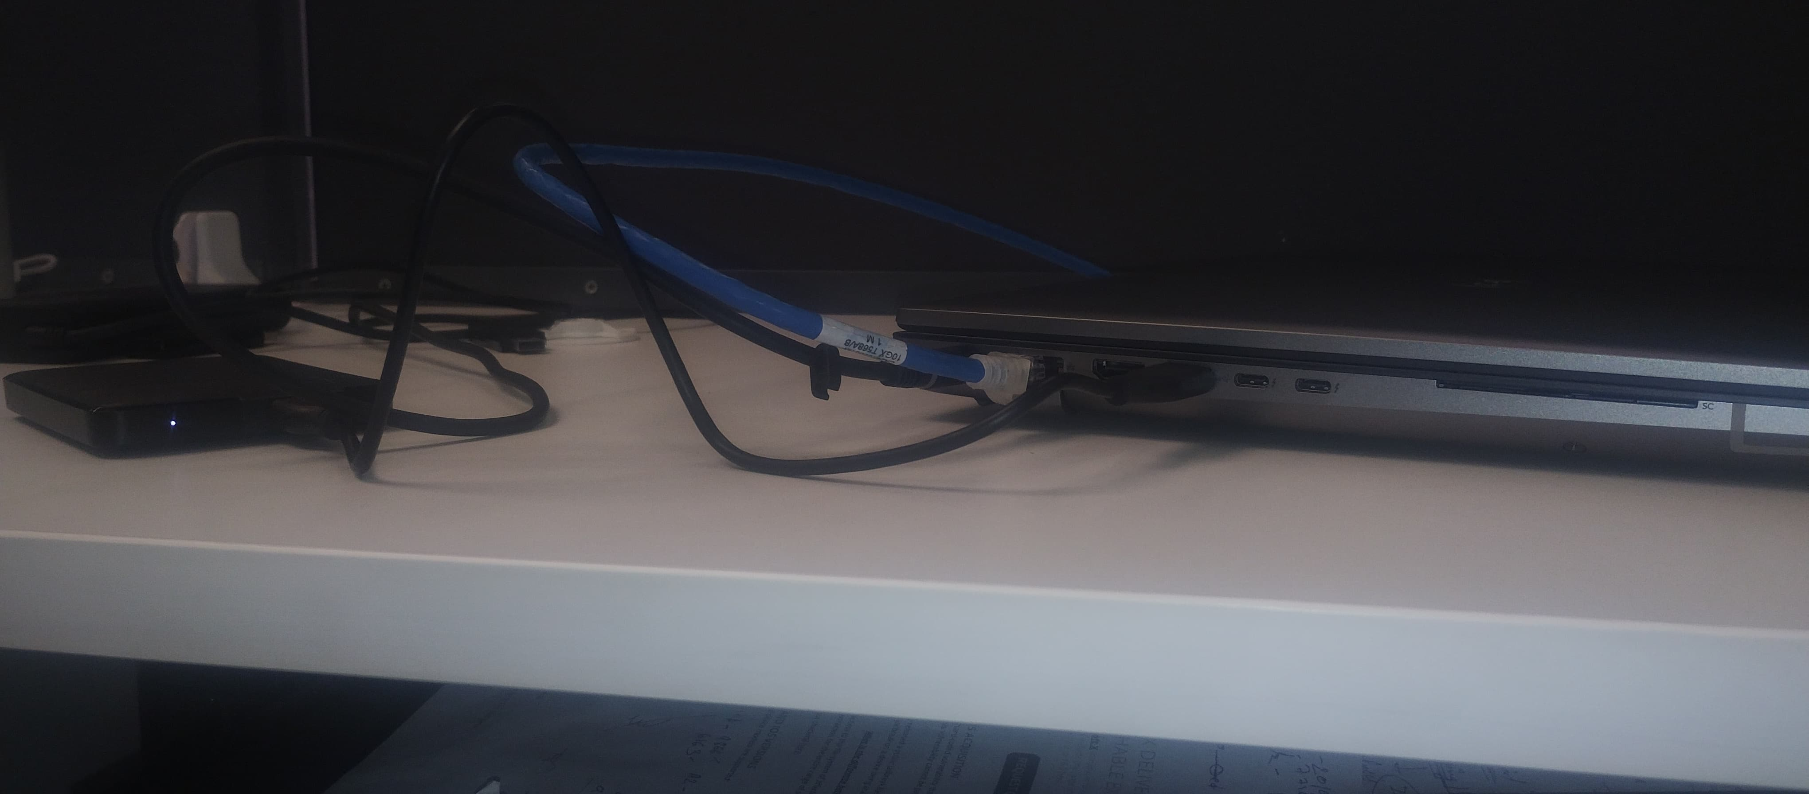
For Laptop if it is in closed position then do not open the lid(screen)
To identify the laptop if it is switched-OFF or in sleep mode.
1) See the power button or see the lights in the side where ports are present.

Slide 22
Procedure in case of Switched off System

Slide 23
Unplug the power and other devices from the socket: it may be in sleep mode and my be accessed remotely.
Label and photograph
( or video) all the
components(in case of
multiple devices
Computer 1,
Computer 2, etc. can
be used).

Slide 24
Record the unique identifiers ( make, model, service Tags No., Part No., serial No., etc.) – the main unit, screen, keyboard and other equipment will have separate identifiers.
Ask for the password to the system and search of additional storage media.
Search the Crime Scene INCLUDING DUSTBIN for diaries, notebooks or pieces of paper with passwords, etc.
Document all steps involved in the seizure of device and components while making videography and noting down each step.

Slide 25
FOR MAKE and MODEL info
WINDOWS
Press Windows Key > type “setting” & press Enter > In search Bar type “About your PC” > Click on it.
GPU: Device Manager: Right-click on the Start button > "Device Manager" > "Display adapters“
MAC
CPU: Apple menu > "About This Mac" > "System Report" > "Hardware" > "Processor".
GPU: Apple menu > "About This Mac" > "System Report" > "Graphics/Displays".
RAM: Apple menu > "About This Mac" > "System Report" > "Memory”

Slide 26
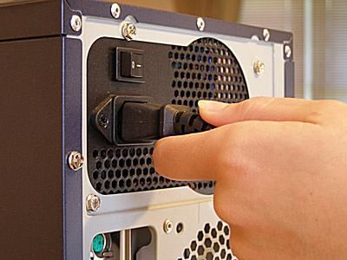
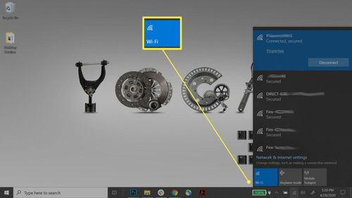
Procedure in case of live system( switched-on)
Do Not Shutdown COMPUTER or LAPTOP
Disconnect the Ethernet Cable(internet cable) from the computer(or Laptop) in case of wifi, close the wifi in the computer( or Laptop).

Slide 27


Record what is on the screen by photography or videography.
If computer is logged out ask for the computer password from accused.

Slide 28

In case of black screen use arrow keys
When the computer or laptop appears
to be in sleep mode.
You can use the live forensic tool to extract the information that is present in the temporary storage memory like RAM(or ask Digital Forensic Expert for the Help).
Label and photograph or video record
all the components.
Record the unique identifiers ( make,
model, service Tags No., Part No.,
serial No., etc.) – the main unit, screen,
keyboard and other equipment will have
separate identifiers.

Slide 29
Do not take advice from the owner / user of the computer.
Pull out the wire of power cord from CPU.
DON’T
SHUTDOWN

Slide 30

Bit Locker Drive

Slide 31

Command to check for bit locked drive:
manage-bde –status
manage-bde -protectors -get C:
Recovery Key:
{12345678-1234-1234-1234-1234567890AB}
manage-bde -off C:

Slide 32
What is hash and it is important.
It is like fingerprint of the data present inside a file or device.
It is unique for the each different file.
In court of law it is used to verify the Integrity and Authenticity of the evidence.

Slide 33
Things to consider before starting the RAM capture :
USB Pen drive(256 GB preferred) or the Destination Drive must be 1.5 times Grater than that of the RAM of the Device Being captured.
Do not turn off the device while the RAM capture is still being performed.

Slide 34

Extracting data from the RAM
Using FTK Imager : 1) making portable FTK Imager

Slide 35

2) Connect the USB to the Device.
3) Go to USB Folder where FTK imager is Present
4) Double Click
5) Click yes on the POP up.

Slide 36


Slide 37


6) Click the File Tab :
7) Click on the capture Memory icon.

Slide 38


8)Click the Browse Button :

Slide 39


9) Select the destination folder and press ok:
10) Check the Include pagefile:

Slide 40


11) Click Capture Memory Button:
12) The Capture of the memory has now begun.

Slide 41

13) After Completing the Task the result will look like:

Slide 42
RAM Extraction in MAC
Volatility Framework
Volatility is a powerful open-source memory forensics framework that can extract RAM contents and analyze memory dumps. However, it requires advanced knowledge and installation of both Volatility and a compatible memory dump.
OSXPMEM
OSXPMEM is a tool for acquiring physical memory on macOS. It creates a memory dump from the system RAM, which you can then analyze using tools like Volatility.

Slide 43
Why RAM Extraction is easy on Computer than MOIBLE
Fewer security restrictions on computers, such as the ability to directly access memory or use built-in tools for memory dumps.
Advance tools for computer systems that support memory extraction without requiring special exploits.
Lower hardware and OS-level constraints on computers that allow direct interaction with system memory..
Lower risk of damaging or bricking the device when dumping memory on computers compared to the more risky and complex processes required for mobile devices.

Slide 44

Pen Drive Imaging
1 Click File Menu, then Select Create Disk Image:

Slide 45

2 Select the source or device to be imaged

Slide 46

3 Select Flashdisk and Finish

Slide 47

4 Select Add

Slide 48

5 Choose the Appropriate Image format

Slide 49

6 Fill in the imaging information on the Evidence form, then Next

Slide 50

7 Select the storage location of the imaging file and give the imaging file a name, then Finish

Slide 51

8 Click Start

Slide 52

9 Wait for the imaging and file verification process to complete.

Slide 53
Hard Disk/SSD Imaging
External storage: You'll need a destination to store the disk image. This can be another hard drive, a network location, or a cloud service.
Free space: Make sure the destination drive has enough free space to store the disk image, as the image file can be as large as the entire used space of the original drive.
Can use tool like Falcon to create and image or clone whatever is required.
MUST USE WRITE BLOCKER IF USING FTK TO MAKE IMAGE.

Slide 54

Analysis of Pen Drive using AUTOPSY
1 Select New Case

Slide 55

2 Fill in the Name case and select the location where the autopsy results will be stored.

Slide 56

3 Fill in Optional Information, then Finish

Slide 57

4 Select Disk Image, then Next

Slide 58

5 Select the data source image, then next

Slide 59

6 Select the information that will be required in configure ingest

Slide 60

7 Wait for the add source to complete

Slide 61

8 Result of Scanning Flashdisk

Slide 62

9 The results of digital data retrieval using Autopsy there are the results of deleted files totaling 333 files

Slide 63

10 There is a result of file metadata that has been deleted

Slide 64

11 To recover deleted data, click extract files

Slide 65

12 Right-click data sources-> Flasdisk.001-> View Summary Information.

Slide 66

Any Questions!

Slide 67
Thank you !

